Slide 1


CDS 590
Mid-Term Presentation
Predicting Real Private Consumption
Using Time Series Data:
A Machine Learning Approach
Supervisor : Mohd Azam Osman
Student Name : Muhammad Azzubair bin Azeman
Mentor : Patrick Lam Kar Jun
Practicum Company : DataMicron Systems Sdn Bhd

Slide 2


Introduction: Background of Company
DataMicron Systems Sdn Bhd is a consultant services company which offers big data solutions and consultation services in data analytics.
As many companies nowadays have their own databases, they face difficulties in gaining insights from raw data using relational database queries.
This is where DataMicron comes as a solution provider in implementing data warehouses for data storage, equipped with visualization tools for data analytics.

Slide 3
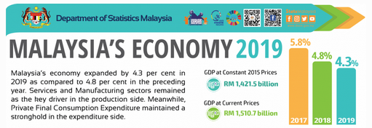
Introduction: Background of Domain
1. What is Real Private Consumption (RPC)?
The amount of goods and services consumed by households to fulfill their basic needs and wants (DoSM, 2020)
2. Why is it important to predict RPC?
RPC is the major contributor (58.7% in 2019) to Malaysia’s GDP (Asada et al., 2019).
Where :
GDP = Gross Domestic Product
C = Private Consumption
G = Government Consumption
I = Investment
NX = Net Export (Import - Export)
3. What is the relation of RPC with GDP?
RPC is one of the indicator of GDP :
GDP = C + G + I + NX

Slide 4
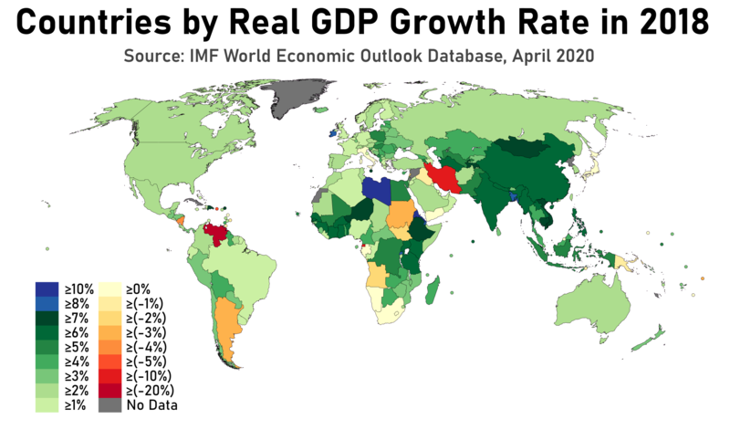
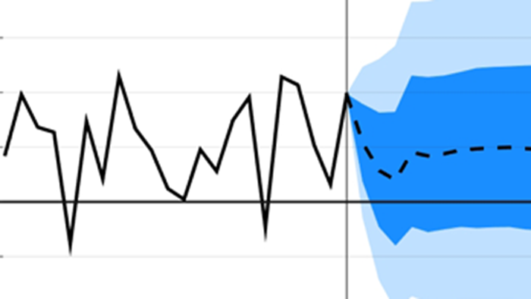
Introduction: Background of Domain
4. What is Gross Domestic Product?
“Market value of all final goods and services produced in economy annually” (Hashim et al., 2018)
5. Why it is important to be concern on GDP?
GDP determines economic advancement of a country. It distinguishes economic status of one country to another.
6. How RPC is currently predicted by Government?
Mixed frequency vector auto regression (MFVAR)
Mixed data sampling (MIDAS)
Unrestricted error correction model (UECM)

Slide 5

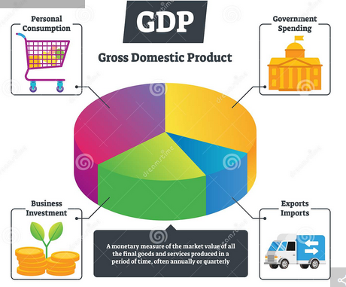
Introduction: Problem Statement
Much studies have been done on comparing between performances of machine learning models with statistical models especially in economics (Yu, 1999; Dematos et. al, 1996; Kumar, 2018).
However, there is no specific study have been done in comparing model performances between machine learning models with statistical models for time series prediction of real private consumption in Malaysia.
The study of machine learning performance will contribute to the understanding of ML approach for time series prediction of real private consumption specifically and macroeconomics generally.

Slide 6
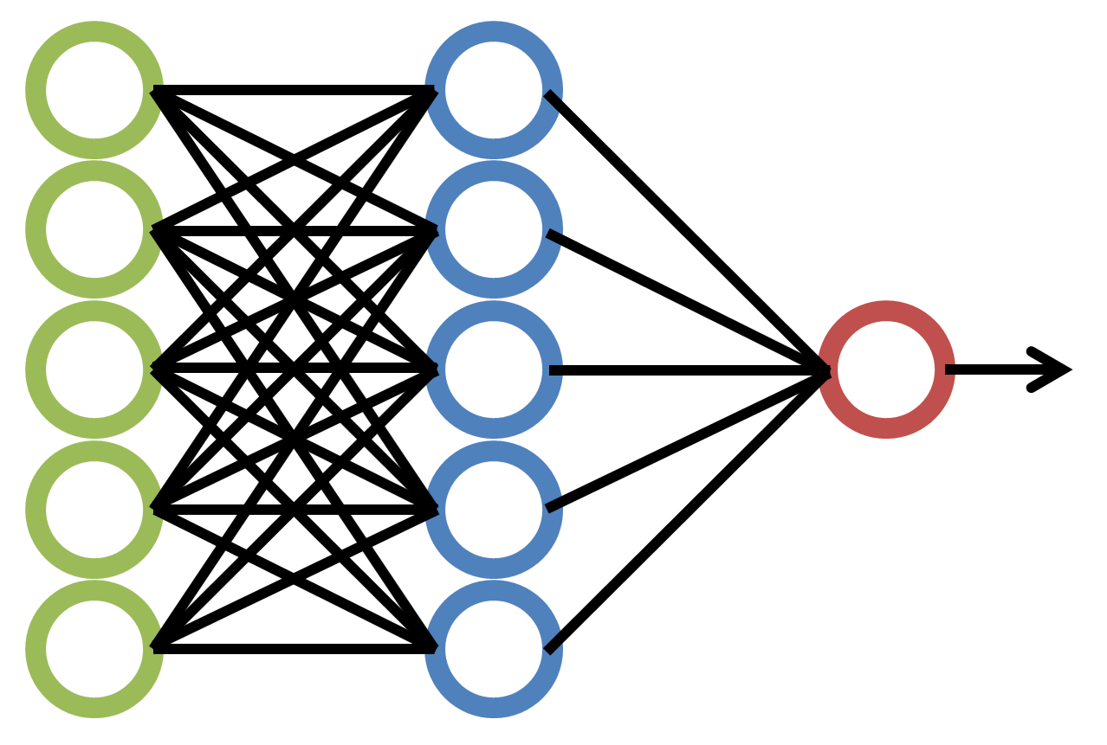
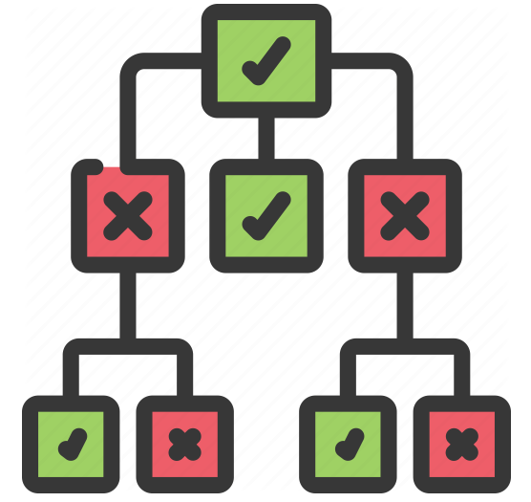
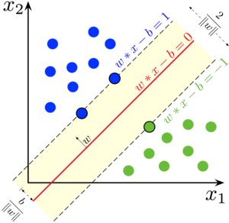




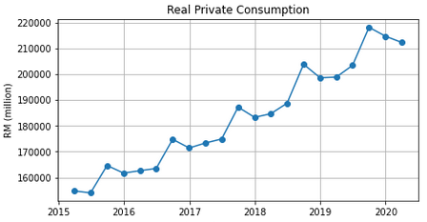
Introduction: Research Question
Throughout this project, the research questions are as following :
Which machine learning model is the most suitable for RPC prediction?
What are the important steps in developing machine learning models to predict RPC?
Between statistical and machine learning approaches, which of them is better in model performance evaluation?
RPC (Q1 2020)
→ RM 212257 mil.
RPC (Q2 2020)
→ ?

Slide 7
Introduction: Objectives
Following the research questions, the objectives are as following :
To investigate the suitable machine learning technique for RPC prediction
To develop RPC prediction model using the selected machine learning approach.
To evaluate prediction performance of the RPC prediction models.
RPC (Q1 2020)
→ RM 212257 mil.
RPC (Q2 2020)
→ ?

Slide 8


Introduction: Benefits of the Project
This project is a consultation project between DataMicron with Fiscal and Economics Division of Malaysia’s Ministry of Finance (MoF).
Therefore, this project will benefit Data Micron in providing proposed solution for their client’s problem.
In return, MoF will use these insights to discuss with MoF’s top management in considering new approach for time series prediction of real private consumption.

Slide 9
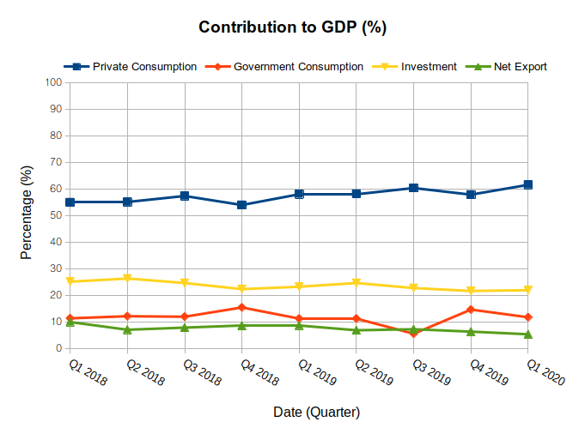
Related Works: Review on Domain
According Ministry of Finance (2019), contribution to GDP is dominantly contributed by Real Private Consumption since 2018.
Following RPC are Investment, Real Government Consumption, and finally Net Export.
Moreover, RPC’s contribution to GDP is quarterly increasing since 2018 (MoF, 2019).
This shows that Malaysia’s GDP is significantly dependent on RPC.
Source: Ministry of Finance (2020)

Slide 10
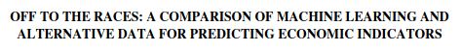
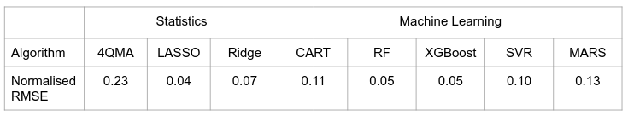
Related Works: Review on DSA Techniques
Table 1 Model Performance Comparison for Quality Service Survey on RPC
Findings : Tree-based Ensemble models resulted on the best predictions. Such models are random forests and gradient boosting. The reason is because they can learn nonlinear patterns of economic indicators. (Chen et al., 2018)

Slide 11
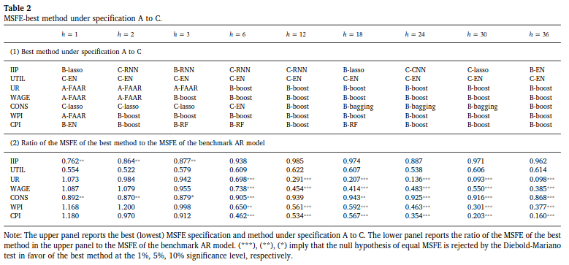
Related Works: Review on DSA Techniques
Table 2 Model Performance Comparison for Macroeconomic Forecasting
Findings : Ensemble learning based on regression trees (bagging, random forests, and boosting) is the best method due to their adaptability with nonlinear trends of macroeconomic indicators. (Maehashi and Shintani, 2020)

Slide 12
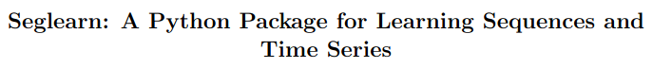
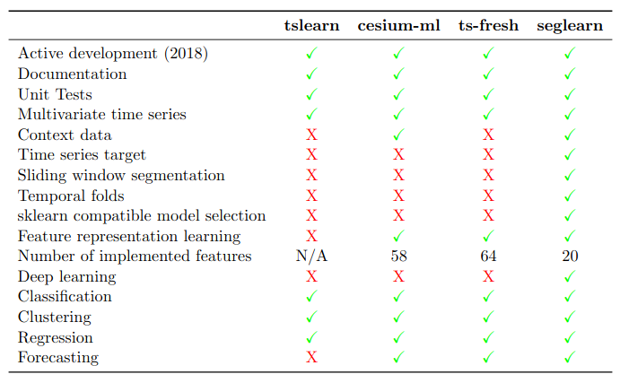
Related Works: Review on DSA Tools
Table 3 Comparison of features between libraries
Findings : seglearn library has the most feature for time series prediction.
: This library also can incorporate classification, regression, clustering, and forecasting tasks.
: Most importantly, seglearn has sliding window segmentation, and adaptable to sklearn models (Burns and Whyne, 2018).
:

Slide 13
Research Methodology: Contribution
Table 4 Contribution Table on achieving the objectives
Objectives | Method used | Contribution
To investigate the suitable machine learning technique for RPC prediction. | Literature Review | Most suitable ML models
To develop RPC prediction model using the selected machine learning approach. | Develop prediction models using the most suitable models | RPC prediction models
To evaluate prediction performance of the RPC prediction models. | Compare performance between: Machine Learning models ML vs Statistical models | Accuracy Result

Slide 14
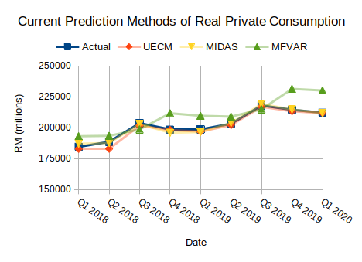
Research Methodology: Problem Analysis
Currently, MoF is finding a methodology to optimise RPC predictions in order to predict future values with higher accuracy.
As of now, their best model is MIDAS followed by UECM and lastly MFVAR.
This is indicated by their prediction error (RMSE) with MIDAS having the least while MFVAR having the most error.
Could Machine Learning outperform these?
Figure 3 Current Prediction Methods of RPC

Slide 15
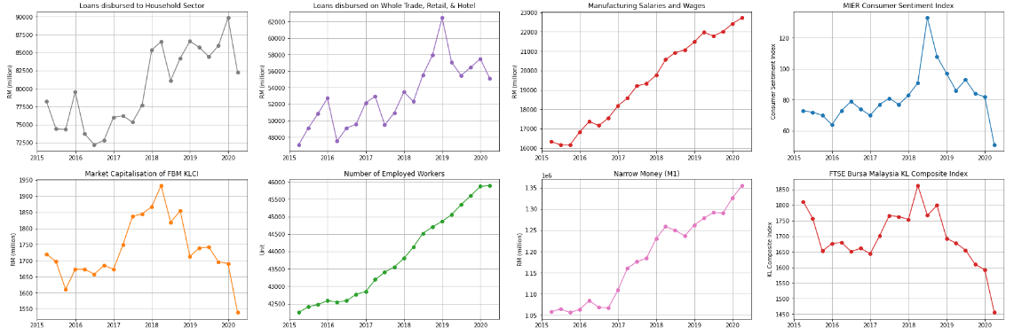
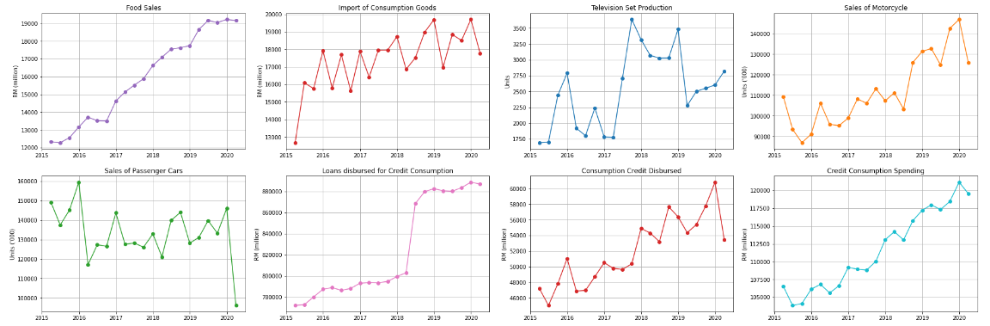
Research Methodology: Exploratory Data Analysis
Prior to the COVID-19 pandemic (Q1 2020), 13 out of 16 RPC indicators show an increasing trend.
Overall, 11 of the 16 indicators show nonlinear trends except for MSW, NM, FS, EMP, and CC.
During Q1 2020, 9 indicators significantly declined

Slide 16
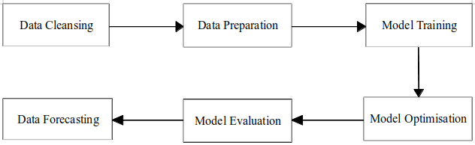

Research Methodology: Final Analysis
Figure 4 Flow chart of model development for RPC prediction models

Slide 17
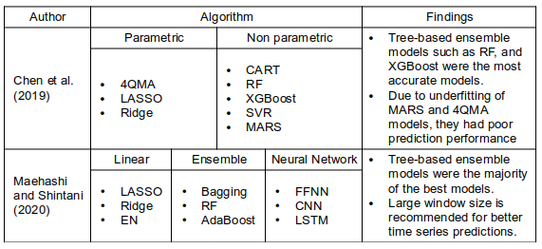
Results and Discussion
Objective 1: To investigate the suitable machine learning technique for RPC prediction
Tree-based ensemble models were the most suitable models
Those models are:
Bagging
Random Forest
AdaBoost
XGBoost
Reason:
Capable of predicting nonlinear trends
Table 4 Summary of Selected Literature Reviews

Slide 18
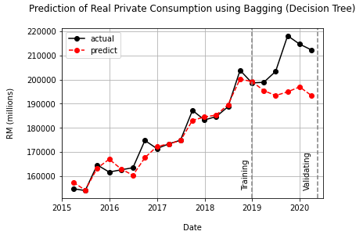
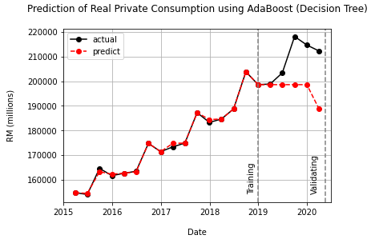
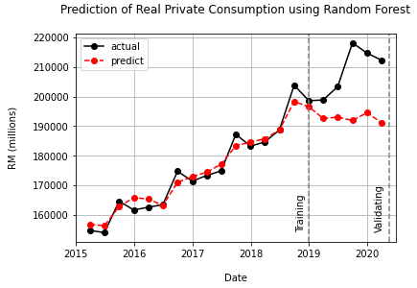
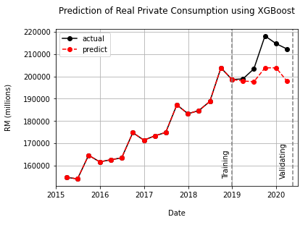
Results and Discussion
Objective 2: To develop RPC prediction model using selected machine learning approach.
Bagging
AdaBoost
Table 5 Model Performance Comparison
 | Bagging | RF | AdaBoost | XGBoost
RMSE | 16264 | 18359 | 15594 | 10633
Currently, Tree-based ensemble models with default parameters were successfully developed.
After this, these models will be optimised to reduce their RMSE values as much as possible.
Random Forest
Random Forest
XGBoost

Slide 19
Conclusion
Currently, this project can be concluded as stated in the following table:
Table 4 Conclusion Summary
Objectives | Status of Achievement | Findings
To investigate the suitable machine learning technique for RPC prediction. | Achieved | Tree-based ensemble models were the most suitable models
To develop RPC prediction model using the selected machine learning approach. | Ongoing | -
To evaluate prediction performance of the RPC prediction models. | Ongoing | -

Slide 20
Thank You

Slide 21
Backup Slides

Slide 22
Related Works: Review on Domain
In particular, RPC is indicated by 18 indicators as published in MoF (2017).
FS
ICG
TSP
SOM
SOPC
CC
CCD
LOWT
CCS
LDH
NM
FBM KLCI
RPC
MCF
MSW
SSW
MSV
MIER
EMP
Source: Ministry of Finance (2017)

Slide 23
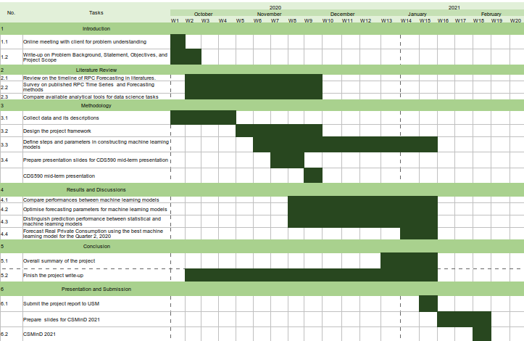
Research Methodology: Activities Plan
From October until early of November, I spent most on the time reviewing articles to select the best algorithms and tools.
Currently, I am still on track with my Gantt Chart as I have developed basic models for all of the algorithm selected.
Figure 1 Gantt Chart of Project Consultancy and Practicum

Slide 24

Research Methodology: DS Lifecycle
As a data scientist, my lifecycle has been rolling throughout the data science lifecycle.
I spent most of the time in modeling phase back-and-forth between Feature Engineering and Model Evaluation.
After satisfied with model evaluation, I will propose the machine learning models for the new approach seek by Fiscal and Economics Division, Ministry of Finance, Malaysia.
Figure 2 Data Science Lifecycle Projects

Slide 25
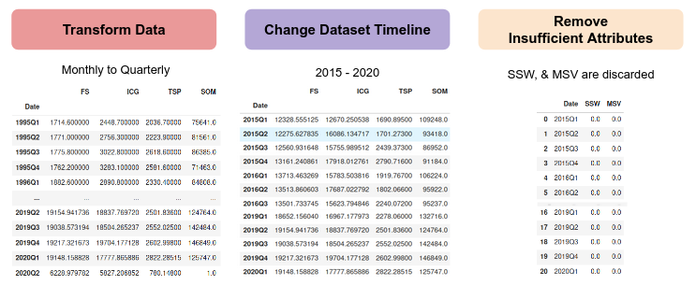
Results and Discussion: Data Cleansing
Figure 7 Output of each process in Data Cleansing phase

Slide 26
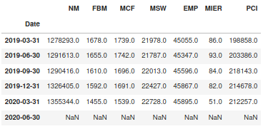
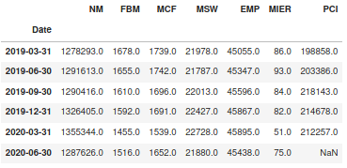
Results and Discussion: Data Preparation
Figure 8 Output of RPC indicators before (left) and after (right) Windowing process

